Slide 1
Land Acknowledgement
Reconnaissance du territoire
We as colleagues at McMaster University facilitate content
on the traditional territories of the Mississauga and Haudenosaunee nations,
and within the lands protected by the “Dish with One Spoon” wampum agreement.
En tant que collègues, nous enseignons à l’Université McMaster sur le territoire traditionnel des Mississaugas et des Haudenosaunees, qui fait partie des
terres protégées par l’accord de la ceinture de wampum dit du
« bol à une seule cuillère ».

Slide 2

Disclosures
Divulgation des affiliations
The VEGA Project (Lead: MacMillan) was funded by the Public Health Agency of Canada (PHAC)
The RISE Project (Lead: Kimber) is funded by PHAC
Le projet VEGA (chef : MacMillan) a été financé par l’Agence de la santé publique du Canada (ASPC)
Le projet RISE (chef : Kimber) est financé par l’ASPC

Slide 3

Child maltreatment overview
Aperçu de la maltraitance envers les enfants

Slide 4


Child maltreatment / Maltraitance envers les enfants
Refers to inflicting harm on a child and also failing to protect them from harm.
Children may be abused by someone they know in a family or in an institutional or community setting or, more rarely, by someone they don’t know (e.g., through the internet).
Fait référence au fait d’infliger un préjudice à un enfant, et aussi au fait de ne pas le protéger contre un préjudice.
Les enfants peuvent être victimes de violence de la part d’une personne qu’ils connaissent, dans une famille ou dans un milieu institutionnel ou communautaire, ou, plus rarement, de la part d’une personne qu’ils ne connaissent pas (p. ex., par Internet).

Slide 5
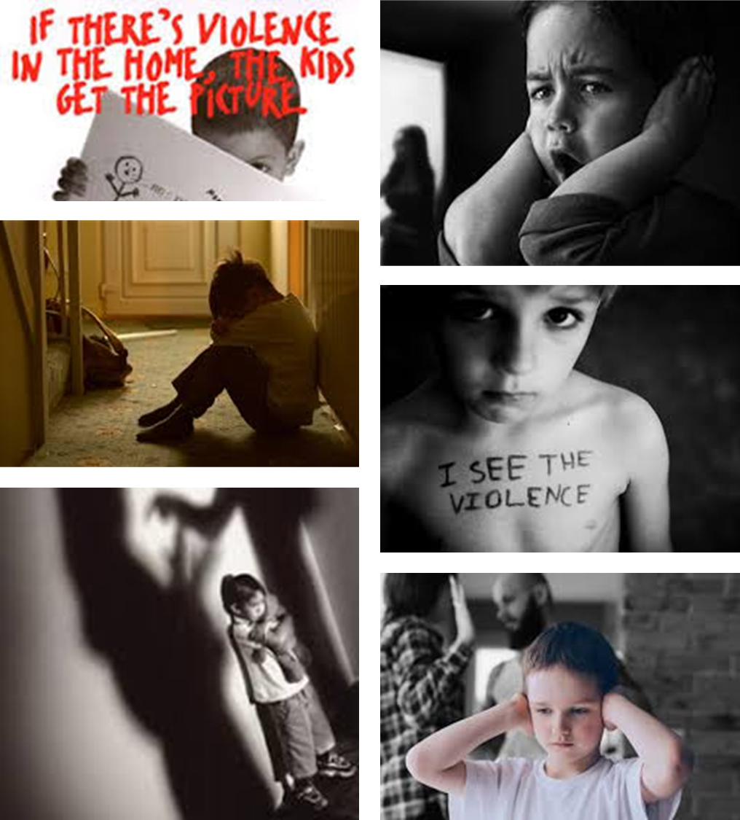
Children’s Exposure to Intimate Partner
Violence (IPV) / Exposition à la violence conjugale (VC)
Children or adolescents’ exposure to or awareness of any incident of violent or threatening behaviour between adults who are or have been intimate partners or family members.
Children exposed to IPV are at increased risk of other types of maltreatment including physical and sexual abuse.
Exposition d’enfants ou d’adolescents à tout incident impliquant un comportement menaçant ou violent survenu entre des adultes qui sont des membres de la famille ou qui sont des partenaires intimes ou l’ont déjà été, ou conscience qu’un tel incident est survenu.
Les enfants exposés à la VC sont davantage à risque de subir d’autres formes de maltraitance, y compris la violence physique et la violence sexuelle.
Notes:
Melissa
Increasingly, children’s exposure to intimate partner violence (IPV) is also considered a form of reportable maltreatment in Canada and in other countries given its high co-occurrence with other forms of maltreatment and its similar potential health and developmental consequences. It refers to… Children or adolescents’ exposure to or awareness of any incident of violent or threatening behavior between adults who are, or have been intimate partners or family members. Includes physical violence (e.g., shoving, hitting, kicking, etc.), as well as exposure to or an awareness of adult sexual violence, emotional abuse, intimidation, controlling actions (isolation) and financial control or abuse that has caused or could cause physical or emotional harm to the child.
Includes physical violence (e.g., shoving, hitting, kicking, etc.), as well as exposure to or an awareness of adult sexual violence, emotional abuse, intimidation, controlling actions (isolation) and financial control or abuse.

Slide 6
Physical Abuse / Violence physique 26%
Prevalence of child abuse, including children’s exposure to IPV
Prévalence de la maltraitance envers les enfants, y compris l’exposition des enfants à la VC
(Afifi et al., 2014)
Sexual Abuse / Violence sexuelle 10%
Any Child Abuse / Maltraitance envers les enfants
32%
Exposure to IPV / Exposition
à la VC 8%
Canadian Community Health Survey 2012
Notes:
Melissa
In Canada, epidemiological data on child maltreatment generally comes from three sources, including incidence studies of reports to child protection authorities, as well as clinical and community-based surveys of youth, adults, and professionals who are asked to retrospectively recall their own or their patient’s exposure to child maltreatment before 16 or 18 years of age. Given that each form child maltreatment can lack overt indicators of occurrence, prevalence rates based on child protection data and retrospective reports by professionals tend to be significantly lower that those based on self-reports of victimization. In addition, given the complicated nature of child maltreatment, as well as the fear and stigma that can be associated with these experiences, experts in the field strongly argue that all current estimates of child maltreatment - likely underestimate the true proportion of the Canadian child, adolescent, and adult population for whom child maltreatment is a reality.
One of the best estimates of self-reported victimization among Canadians comes from the 2012 Canadian Community Health Survey, which asked a representative sample of adult Canadians to retrospectively report the frequency with which, prior to the age of 16 years, they experienced physical or sexual abuse, or exposure to IPV.

Slide 7
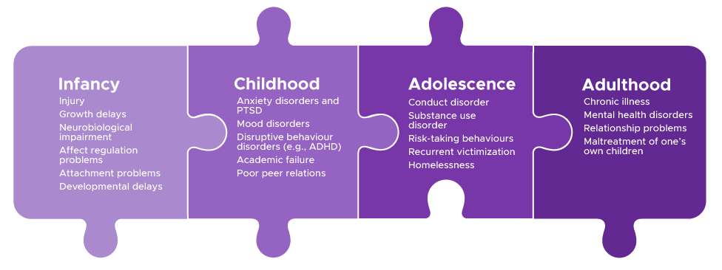
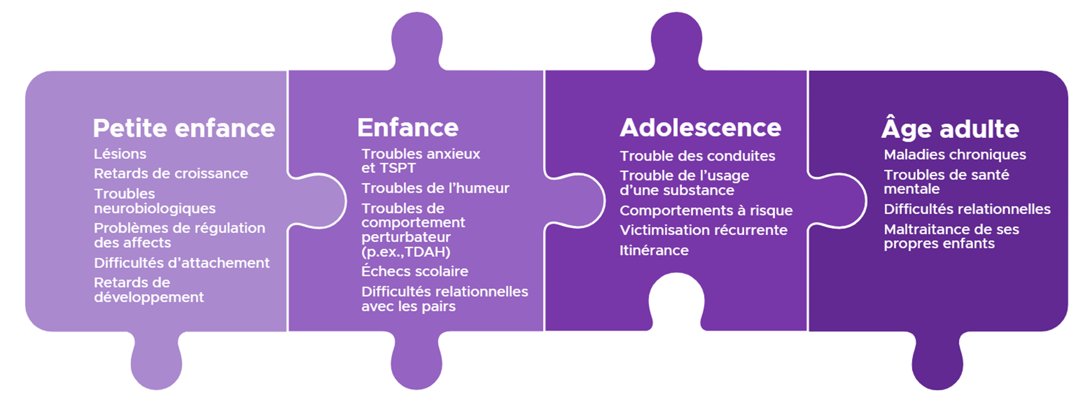
Impairment Across Lifespan / Perturbations au cours de la vie
Notes:
Melissa
Several systematic reviews and meta-analyses indicate that exposure to each form of child maltreatment can lead to similar negative health outcomes over the life course. These include elevated risk for the onset and persistence of mental disorders, lower academic and employment-related achievement, increased risk for violent victimization in adulthood, self-harm, suicide, substance use and abuse, reproductive health problems, as well as metabolic and cardiovascular-related diseases. Some of the specific conditions and outcomes noted in the literature and which map to each stage of the lifespan are on your screen. Including in infancy, when abusive head trauma is of particular relevance and concern, there are heightened risks of [read off slide]…

Slide 8


Impact on Biological Systems /
Effets sur les systèmes biologiques
Alterations to the physiological system responsible for regulating stress in our bodies; the hypothalamic-pituitary-adrenal (HPA) axis
Altération du système physiologique responsable de la régulation du stress dans l’organisme : l’axe hypothalamo-hypophyso-surrénalien (HHS)
Structural and functional alterations to the brain regions that support our ability to identify, label, and adaptively process our emotions
Altérations structurelles et fonctionnelles des régions cérébrales qui soutiennent notre capacité à reconnaître, à nommer et à gérer nos émotions de façon adaptative
Notes:
Finally, there is growing research which tells us that Child Maltreatment exposure can have enduring impacts on young people over the life course given its ability to get under the skin. And what do we mean by this, well, the stress and impacts of child maltreatment can become embedded in biological systems, including the hypothalamic-pituitary-adrenal (HPA) axis, which is our central stress response system. Repeated and prolonged exposure to child maltreatment can result in an overactive or underactive HPA axis, and both cases have been shown to demonstrate increased vulnerability to MH problems among maltreated individuals over the life course.
Second, brain imaging studies have identified that again, repeat or extreme exposure to maltreatment can cause structural and functional alterations in brain regions implicated in emotion regulation, that is, our ability to identify, label, and adaptively process our emotion states. When we have challenges with processing our emotion states, there is a higher likelihood that we develop or engage in harmful strategies to manage the intensity of our emotions and that can include many of harmful behavioral and psychological symptoms, including use of substance, sexual activity, disordered eating and exercise, cutting, and etc.

Slide 9
Recognizing and responding safely to child maltreatment
Reconnaître la maltraitance envers les enfants et répondre en toute sécurité

Slide 10


Recognizing and Responding to Child Maltreatment / Reconnaître la maltraitance envers les enfants et y répondre
Prevention before occurrence / Prévention avant l’occurence
Prevention of recurrence / Prévention de la récurrence
Prevention of impairment / Prévention des séquelles
Child Maltreatment / Maltraitance envers les enfants
Long-term Outcomes / Résultats à long-terme
Intervention
Universal / Universelle
Targeted / Ciblée
Adapted from / Adapté d’après MacMillan et al., Lancet 2009

Slide 11
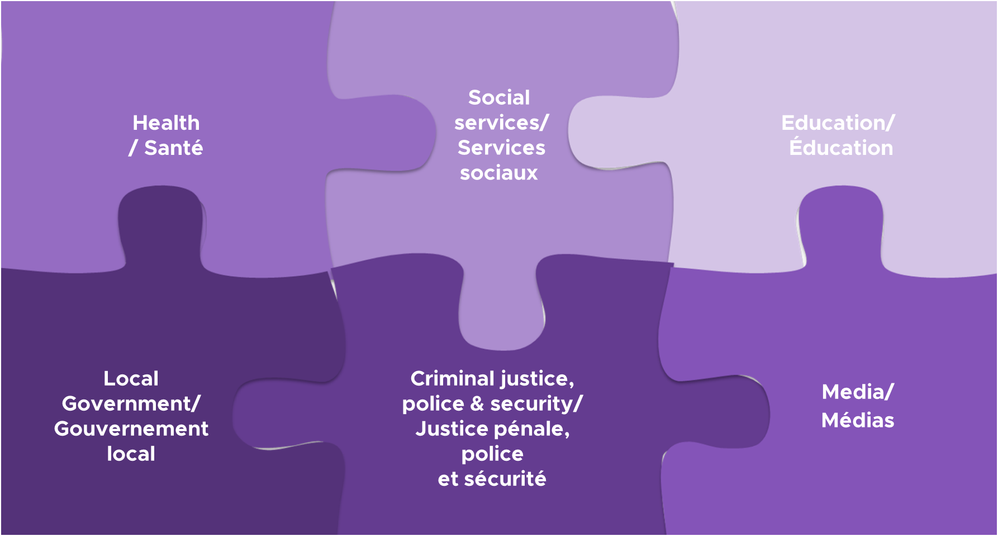
A multi-sectoral approach is required in preventing and responding to child maltreatment; the health
sector has an important role (WHO, 2018). / Il faut adopter une approche multisectorielle pour prévenir
la maltraitance envers les enfants et y réagir; le secteur de la santé a un rôle important à jouer (OMS, 2018).

Slide 12

What’s the evidence for identifying CM? /
Reconnaître la ME – quelles sont les données à l’appui?
1. No evidence to support child maltreatment screening (McTavish et al., 2020; WHO, 2018)
Pas de données à l’appui d’un dépistage universel de la maltraitance envers les enfants (McTavish et al., 2020; OMS, 2018)
3. Understand the difference in the role of child protection workers compared with other providers (VEGA, 2020)
3. Comprendre la différence entre le rôle des intervenants en protection de l’enfance et celui des autres professionnels (VEGA, 2020)
2. Need to be alert to signs, symptoms and risk factors
(WHO, 2018)
2. Être vigilant à l’égard des signes, des symptômes et des facteurs de risque (OMS, 2018)
4. Providers should assess for child maltreatment when indicated and without putting the child at increased risk (WHO, 2018)
4. Les professionnels devraient évaluer la présence de maltraitance, s’il y a lieu, sans exposer l’enfant à un risque accru (OMS, 2018)

Slide 13




Funded by the Public Health Agency of Canada
(2015-2020)
Financé par l’Agence de la santé publique du Canada
(2015-2020)

Slide 14
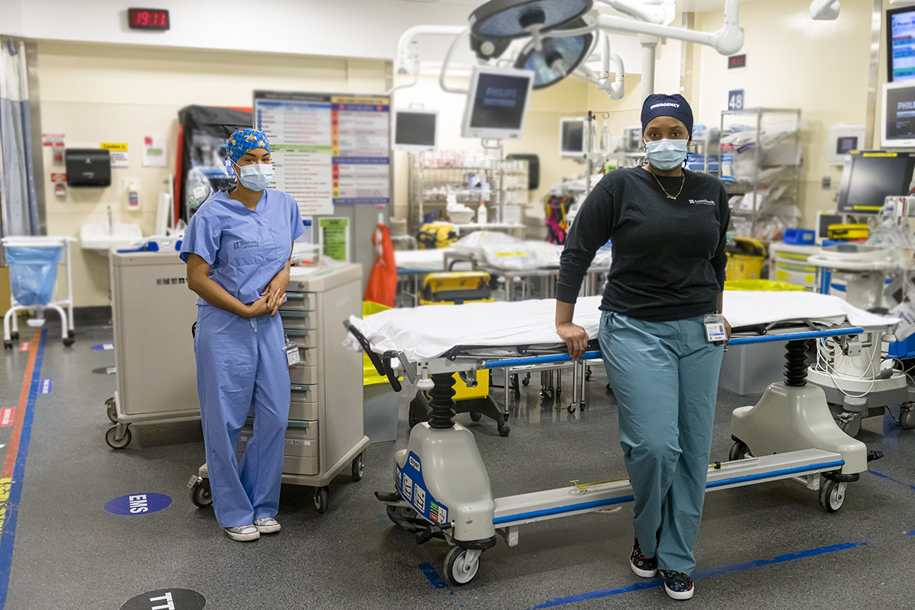
Need for evidence-based healthcare & social service response /
Nécessité d'une réponse des services sociaux et de santé fondée sur des données probantes
« Nous travaillons dans un service d’urgence très occupé. Ces questions prennent beaucoup trop de temps à traiter, surtout si on ne peut pas maintenir la confidentialité! De plus, nous ne reverrons jamais le patient, alors comment pouvons-nous développer le type de relation dont vous avez besoin pour aider quelqu'un à surmonter ce genre de problème. »
“We work in a busy ER. These issues take way too long to address, especially when there’s no privacy! Also, we will never see the patient again so how can we develop the kind of relationship you need to help someone through this kind of issue.”

Slide 15
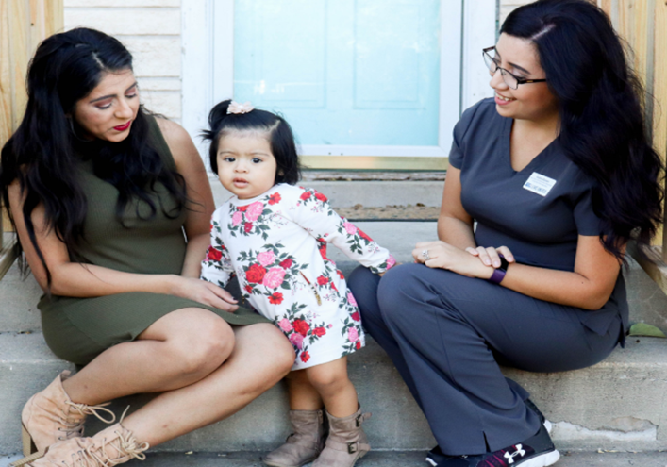
Need for evidence-based healthcare & social service response /
Nécessité d'une réponse des services sociaux et de santé fondée sur des données probantes
“No one taught us in Nursing School how to help people who were getting beat up every day.”
« Personne ne nous a appris à l’École de soins infirmiers comment aider les gens qui se faisaient battre tous les jours. »

Slide 16




VEGA’s Evidence-based Guidance Foundation / Fondements de la guidance fondée sur les données probantes du projet VEGA
Quantitative and Qualitative Systematic Evidence Reviews
Revues systématiques de la recherche quantitative et qualitative
1
2
Stakeholder Consultation
Consultation des intervenants
Voices of Those with Lived Experiences
Témoignages de personnes ayant vécu de la violence
Qualitative Interviews
Entrevues qualitatives
4
3

Slide 17

Creating Safety /
Créer la sécurité
Safe interactions and environments / Créer des interactions et des environnements sécuritaires
Using a trauma- and violence-informed care framework / Avoir recours à une approche de soin tenant compte des traumatismes et de la violence
Includes patient/client physical, emotional and cultural safety / Tenir compte de la sécurité physique, émotionnelle et culturelle des patients ou des clients

Slide 18
WHY the ‘V’ in TVIC / POURQUOI le « V » dans l’approche de soin tenant compte des traumatismes et de la violence?
Trauma-informed care (TIC)
a framework that addresses the environment within which h ealthcare and social services are delivered
recommendations about practices that enable aspects of the environment to be sensitive and responsive to potential impacts of trauma
principles include a culture of safety (e.g., not re-traumatizing) and a strengths-based and collaborative approach to care
Trauma- and violence-informed care (TVIC)
extends the TIC framework with the addition of ‘v’iolence to emphasize the association between trauma and violence
acknowledges the intersections and additive effects among:
  past or current interpersonal violence (e.g., child maltreatment)
  systemic violence (e.g., racism, discrimination and colonialism) and
  negative outcomes (e.g., poor health, lack of access to care)
L’approche de soin tenant compte
des traumatismes
cadre qui prend en compte l’environnement dans lequel les services sociaux et de santé sont dispensés
recommande des pratiques pour adapter les éléments de l’environnement en fonction des conséquences possibles du traumatisme
les principes incluent une culture de sécurité (par exemple, ne pas retraumatiser) et une approche de collaboration axée sur les forces
L’approche de soin tenant compte
des traumatismes et de la violence
élargit le cadre de soin tenant compte des traumatismes en y ajoutant la ‘v’iolence afin de faire ressortir le lien entre les traumatismes et la violence
reconnaît les recoupements entre les éléments suivants ainsi que leur effet cumulatif :
  épisodes de violence interpersonnelle courants ou passés (par exemple, maltraitance envers un enfant)
  violence systémique (racisme, discrimination, colonialisme, etc.)
  résultats négatifs (mauvaise santé, manque d’accès aux soins)

Slide 19
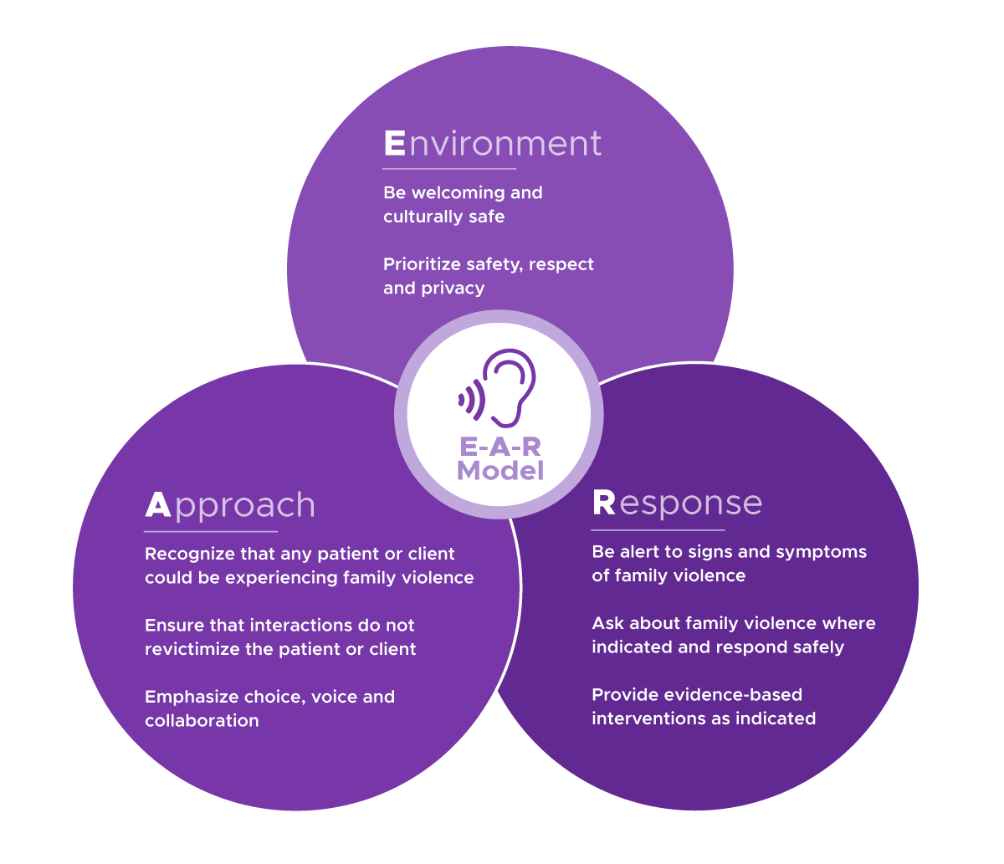
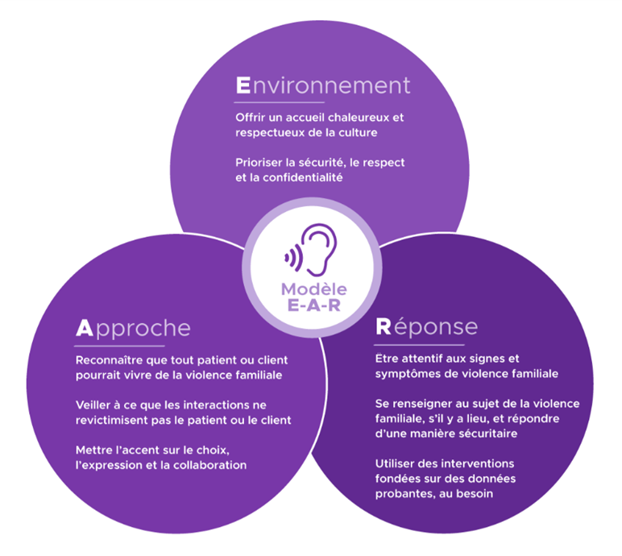
Environment, Approach and Response (EAR) Model
Modèle EAR Environnement, Approche et Réponse

Slide 20
Examples of learning module content
Exemples de contenu de modules d'apprentissage
how-to videos / des vidéos didactiques
Educational scenarios / Scénarios éducatifs
Scripts /
Des exemples de dialogue
Knowledge checks / Vérification des connaissances
Reflections / Réflexions

Slide 21
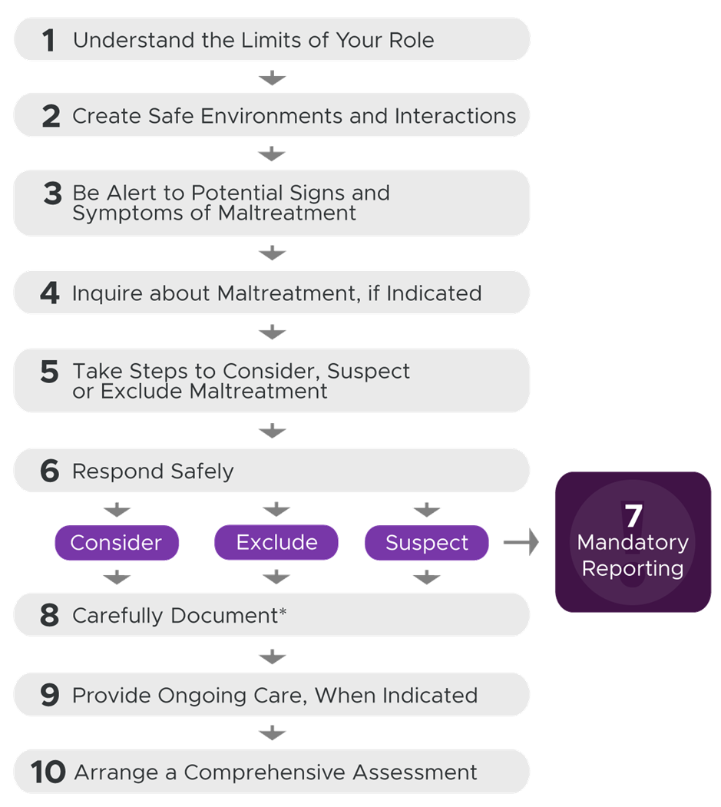
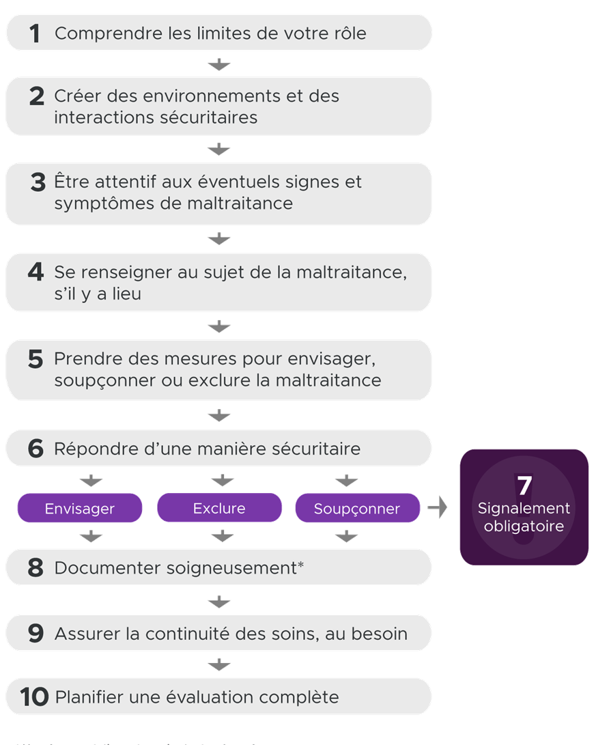
Child Maltreatment Care Pathway
Parcours de soin pour la maltraitance envers un enfant

Slide 22

Preamble:
Préambule :
Ask the child who is in their household. Once the child indicates who is in their family, you may ask:
“How do the people in your family get along?”
“What do you like about [each person in the family]?” “What do you dislike about [each person in the family]?”
“Has anyone ever made you feel afraid? Can you tell me about that?”
“What happens when people in your family get mad/angry?”
“What do they do?”
“Do people in your family ever fight?" "If so, who?” “What does that look like?”
“Does anything else happen?”
“What is the worst thing that happens?”
“What happens when you get in trouble or don’t listen to [your caregivers]?”
Demandez à l’enfant qui habite à la maison. Une fois que l’enfant a nommé les membres de sa famille, vous pouvez demander :
« Est-ce que les membres de ta famille s’entendent bien entre eux? »
« Qu’est-ce que tu aimes de [chaque membre de la famille]? » « Qu’est-ce que tu n’aimes pas de [chaque membre de la famille]? »
« Est-ce que tu as déjà eu peur de quelqu’un? Peux-tu m’en parler? »
« Que se passe-t-il lorsque des membres de ta famille se fâchent ou sont en colère? »
« Que font-ils? »
« Est-ce qu’il y a des chicanes dans ta famille? Qui se chicanent? » « Peux-tu me donner un exemple? »
« Se produit-il autre chose? »
« Quelle est la pire chose qui se produit? »
« Que se passe-t-il lorsque tu fais une bêtise ou n’écoutes pas [tes figures parentales]? »
Then:
Ensuite :
Questions for
Children / Questions à poser aux enfants

Slide 23
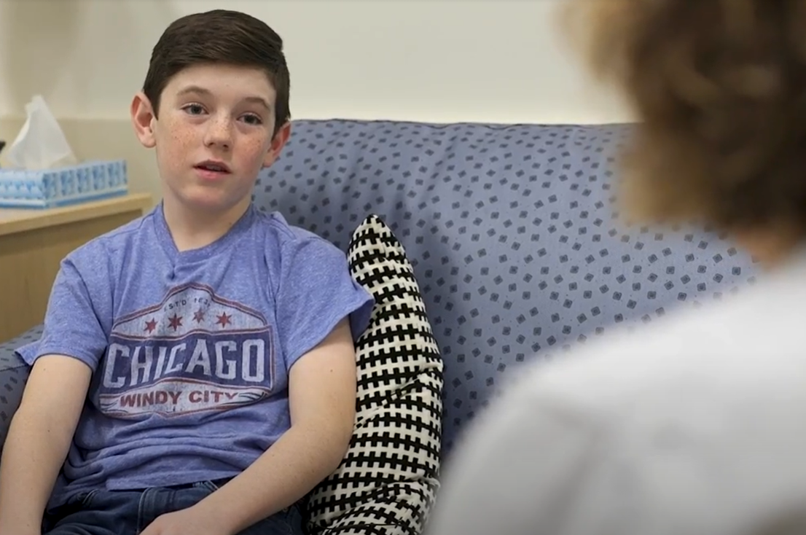

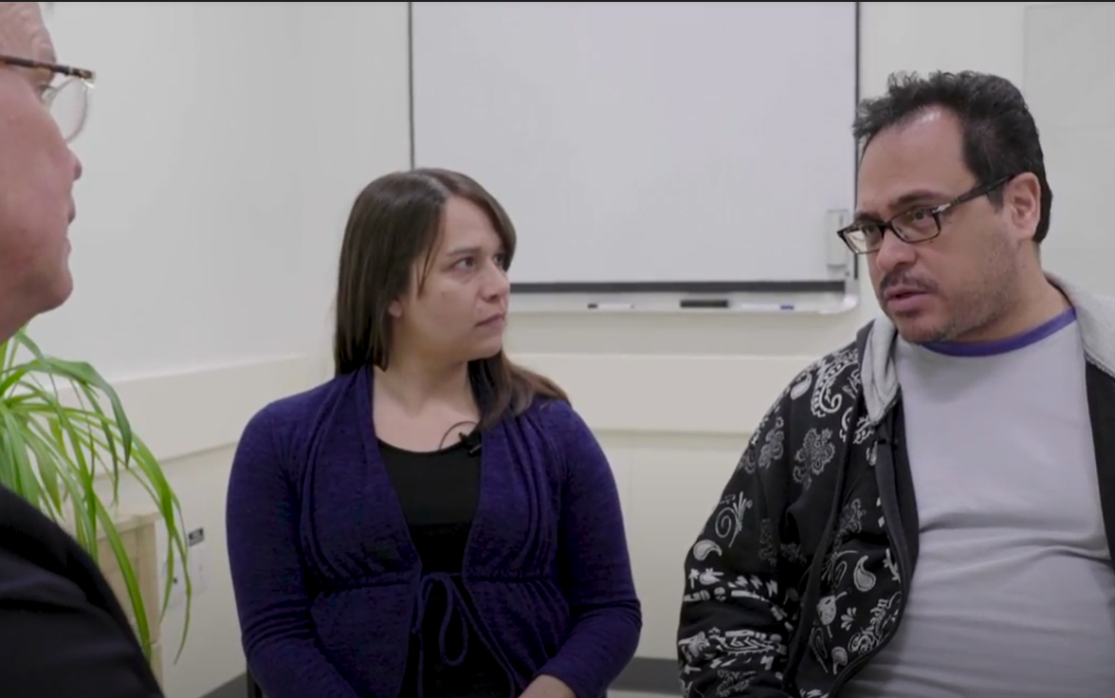
Child Maltreatment How-to Videos
Vidéos didactiques sur la maltraitance envers les enfants
Notes:
HARRIET’s LAST SLIDE
CM GAME Link: http://vega-dev.stitchmedia.ca/

Slide 24
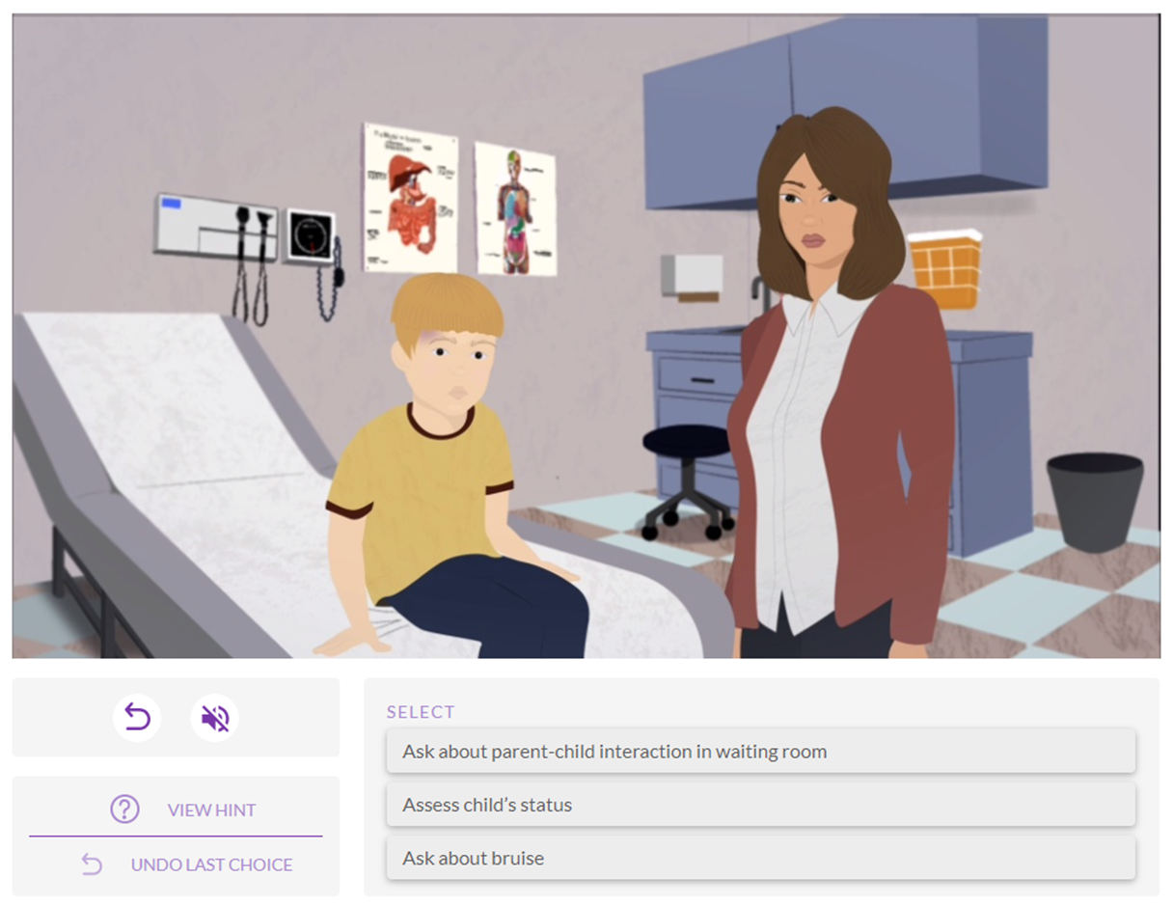
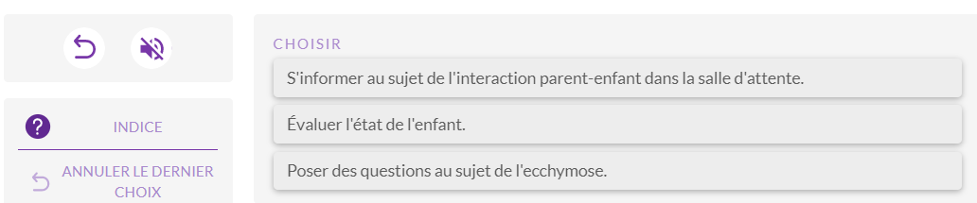
Educational Scenario:
Recognizing and Responding Safely to Child Maltreatment
Scénario éducatif:
Reconnaître la maltraitance envers les enfants et répondre en toute sécurité

Slide 25


Funding provided by the Public Health Agency of Canada / Financé par l’Agence de la santé publique du Canada
2019-2023
Notes:
Melissa
To end our last 5 minutes, I want to share with you some important information about the evaluation of VEGA. While it is certainly an evidence-informed educational intervention (meaning it was developed on the best available evidence on how to safely recognizing and respond to IPV and children maltreatment), and we have received very positive informal feedback, it has not yet been formally evaluated. Thus, we can t say with certainty that by completing the VEGA modules, it will knowledge and skill changes in your practice. However, a formal evaluation is now underway and that is called, Researching the Impact of Service Provider Education – or what we call, the RISE Project – which is a program of work that I am leading in collaboration with Dr. Meredith Vanstone – who is an education scholar at McMaster University, and Dr. Donna Stewart, who is a psychiatrist and expert in gender-based violence at the University of Toronto and University Health Network.
The RISE Project is funded by the Public Health Agency of Canada and …. [ NEXT SLIDE

Slide 26
Objectives of the RISE Project
Objectifs du projet RISE
Identify & create implementation drivers for the pan-Canadian uptake of VEGA as a health professional education intervention (current funding).
Evaluate the perceived value & impact of VEGA to lead to improvements in:
  practitioner recognition and response to family violence (current funding)
  the well-being of individuals and families who have experienced or who are at risk of experiencing family violence (future funding)
Déterminer et créer des facteurs de mise en œuvre pour l’adoption pancanadienne de VEGA comme intervention d’éducation des professionnels de la santé (financement actuel).
Évaluer la valeur et l’impact perçus de VEGA pour améliorer :
  la capacité des praticiens à reconnaître la violence familiale et à y répondre (financement actuel);
  le bien-être des personnes et des familles qui ont été victimes de violence familiale ou qui risquent de l’être (financement futur).
Notes:
Melissa
Over 3.5 years, we will….
Use a model of implementation science and a three-phase mixed method approach that will involve the collection and integration of qualitative and quantitative data at multiple timepoints to [read objectives]

Slide 27
Collaborating Organizations / Organisations collaboratrices
Canadian Paediatrics Society / Société canadienne de pédiatrie
Canadian Psychiatric Association / Association des psychiatres du Canada
Child Welfare League of Canada / Ligue pour le bien-être de l’enfance du Canada
College of Family Physicians Canada / Le Collège des médecins de famille du Canada
Canadian Association for Emergency Physicians / Association canadienne des médecins d’urgence
Association of Faculties of Medicine Canada / L’association des facultés de médecine du Canada
Royal College of Physicians & Surgeons of Canada / Collège royal des médecins et chirurgiens du Canada
Canadian Association of Social Workers / Association canadienne des travailleuses et travailleurs sociaux
Notes:
To accomplish this work, we are collaborating with eight national level organizations on the RISE project, which are listed here. “Champions of family violence education within each of these organizations have committed to supporting the implementation and evaluation VEGA among their combined ~85,000 physician and ~22,000 social work members over the course of the project.

Slide 28
The RISE Project / Le projet RISE
Phase 1
(2020-2021)
National-level mixed method study of CM learning needs and preferences among physicians & social workers. /
Évaluation nationale à méthode mixte des besoins et préférences de formation des médecins et des travailleurs sociaux quant à la ME.
Phase 2
(2021-2022)
User-testing of VEGA with physicians & social workers in Alberta, Ontario, & Quebec. /
Essais pilotes de la mise en œuvre de l’intervention VEGA auprès de médecins et de travailleurs sociaux en Alberta, en Ontario et au Québec.
Phase 3
(2021-2023)
Mixed method, open pilot trial of VEGA in three primary care clinics in each of Ontario, Alberta, & Quebec. /
Essai pilote ouvert à méthode mixte sur l’intervention VEGA dans trois cliniques de soins primaires en Ontario, en Alberta et au Québec.
Notes:
Melissa
Most of the project activities are occurring in Ontario, Alberta and Quebec and some are national in scope.
For Phase 1 of the Project, we are pursuing a series of parallel activities that focus on the identification and development of implementation and evaluation supports for the uptake of VEGA among physician and social work. Phase 2 of the project will involve usability testing with trainee and licensed social workers and physicians and will provide the first quantitative estimates of VEGA education impact. And finally, Phase 3 will determine the acceptability and feasibility of conducting a cluster-based, randomized controlled trial for evaluating the impact of VEGA on provider knowledge, attitudes skills and behaviours in the in the primary care setting.

Slide 29



Register for free at / Inscrivez-vous
gratuitement :
https://riseproject.mcmaster.ca/
For more information, contact / Pour de plus amples renseignements, communiquez avec :
Melissa Kimber, riseproject@mcmaster.ca
@RISE_McMaster
https://vegaproject.mcmaster.ca/
For more information, contact / Pour de plus amples renseignements, communiquez avec :
Harriet MacMillan,
vega@mcmaster.ca
@VEGA_Canada

